Slide 1


Final Project - Phe Phase B
Hadar Iluz & Matan Ben Hayon
https://altizachen123.onrender.com/

Slide 2



Roadmap
Introduction
Our Solution
And
Architecture
Verification
Motivation
Preliminary Research
Challenges
Demonstration
1

Slide 3

The Motivation
Ecological problem: People would rather throw away products they don't need than finding someone who needs them.
Reliability: There is no reliability in second-hand products.
Accessibility: Outdated and inconvenient technologies.
It is difficult to find a product in conditions that suit the customer, such as close location.
2

Slide 4
Introduction
The site 'Altizachen' contains all the solutions for the same problems we mentioned earlier - Ecological, reliable and accessible.
The site connects a product to new owners, and so protecting the environment and creating a new culture - Consumption of second hand products.
We focus on 3 things that emerged from our preliminary research:
Location- filters products by location.
User friendly UI- menu that is easy to use.
Reliability- create a user ranking based system.
3

Slide 5
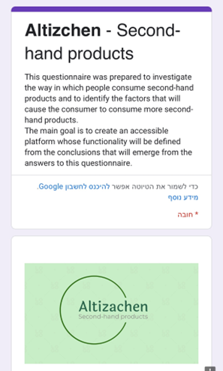
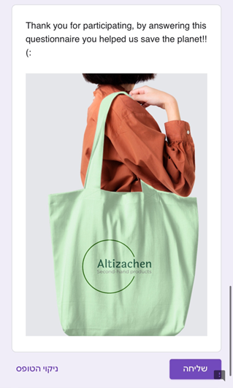


Preliminary Research
Link to 'Altizachen' questionnaire
Distributed in:
Facebook groups for second hand products.
Colleagues, friends and students.
4
send

Slide 6
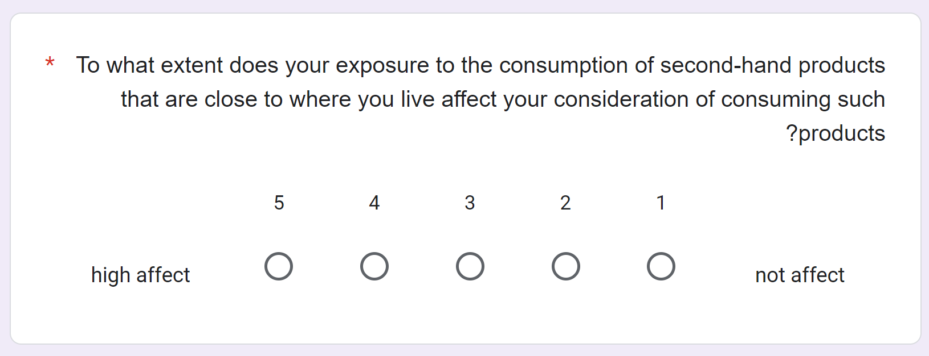
Preliminary Research
Indicating that presenting products that are closer to the user geographically, will significantly increase the chance that the user will want to consume second-hand products.
5

Slide 7
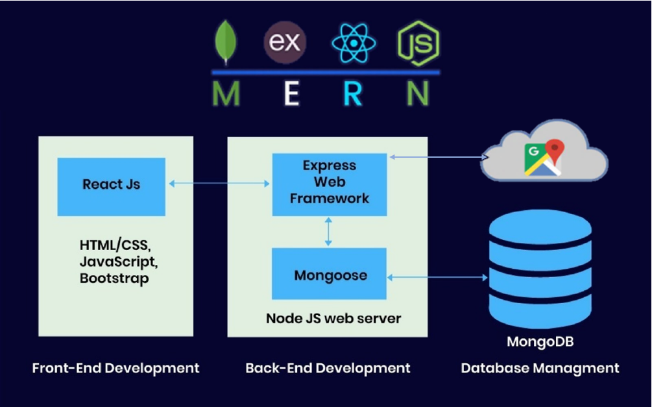
Architecture
MongoDB
Node.js
React
Google Maps API
Express.js - allows developers to define routes, handle HTTP requests and responses, and manage middleware to handle various functionalities such as authentication, logging, and error handling.
6

Slide 8
Our Solution
Using Google Map API and user Ip to direct and present sorted products to the user.
Location
Rating Donors
Reward high rated users by adding an additional VIP ads screen where they will be exposed to new ads 3 days before everyone else.
Classify Ads
Ability to classify smart categories to get to the relevant ads quickly.
Details
Display full information on each product.
7

Slide 9
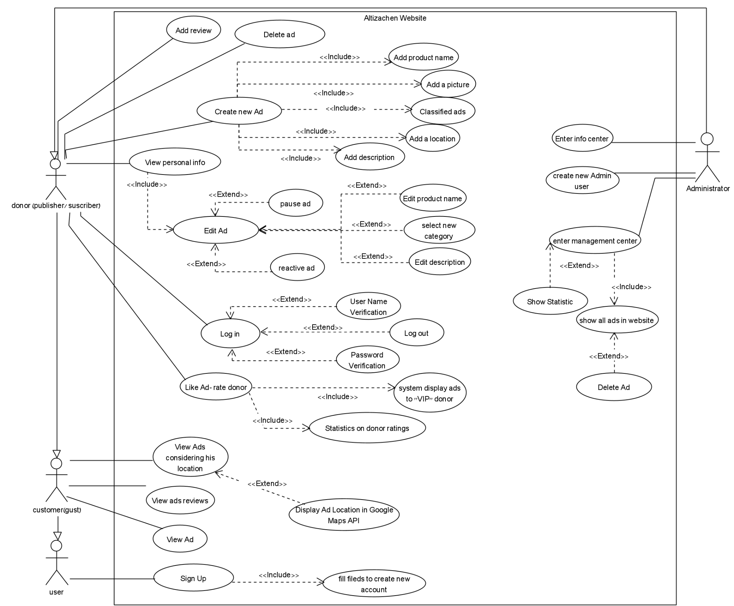
Use case diagram
8

Slide 10
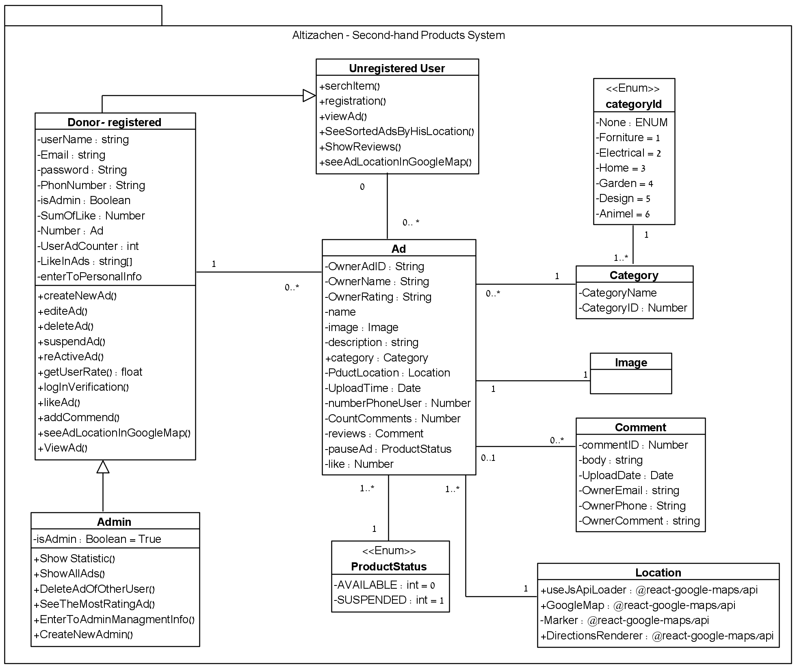
Class diagram
9

Slide 11
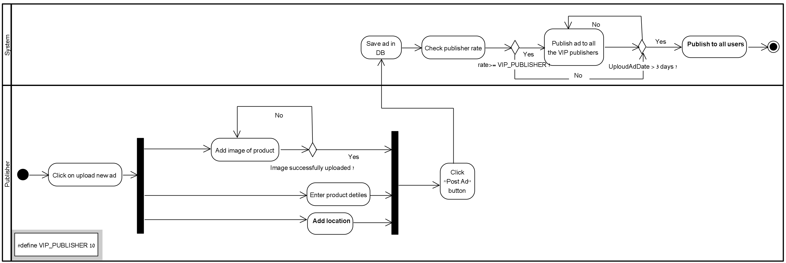
Activity diagram
Upload new product
10

Slide 12
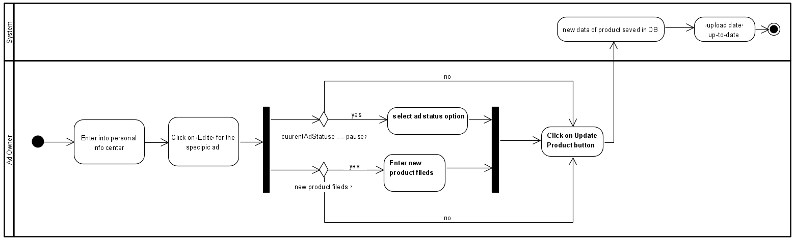
Activity diagram
Edit product
11

Slide 13
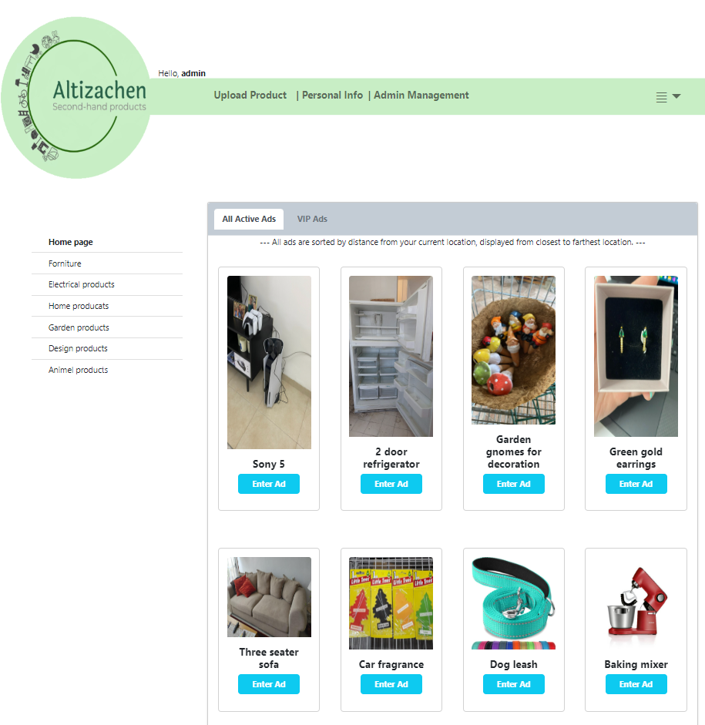
The Website – Home page
12

Slide 14
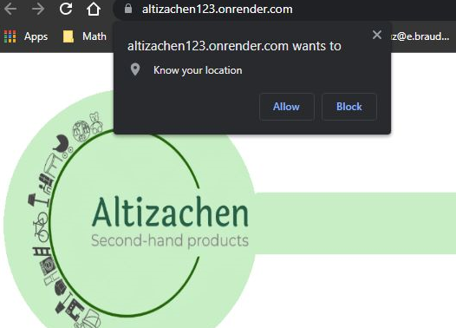
The Website
13

Slide 15
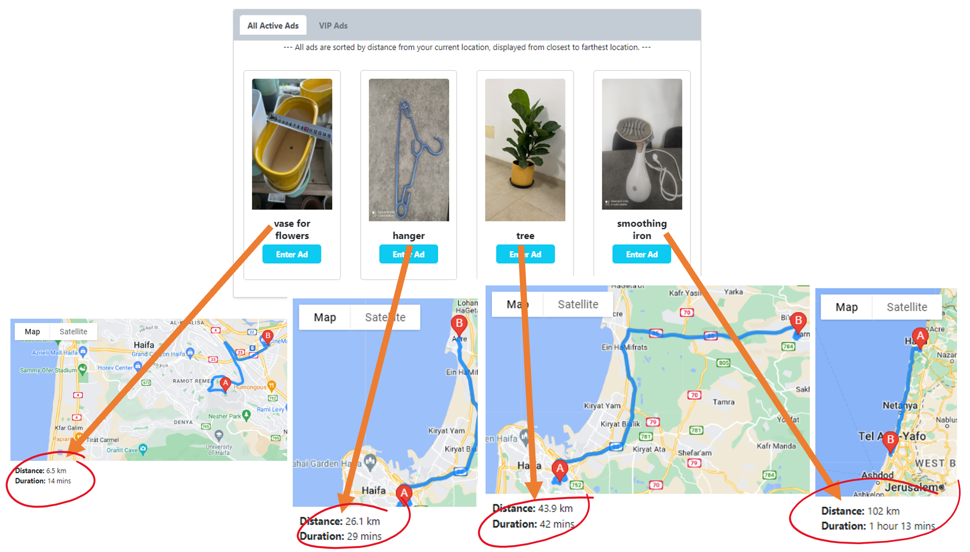
The Website
14

Slide 16
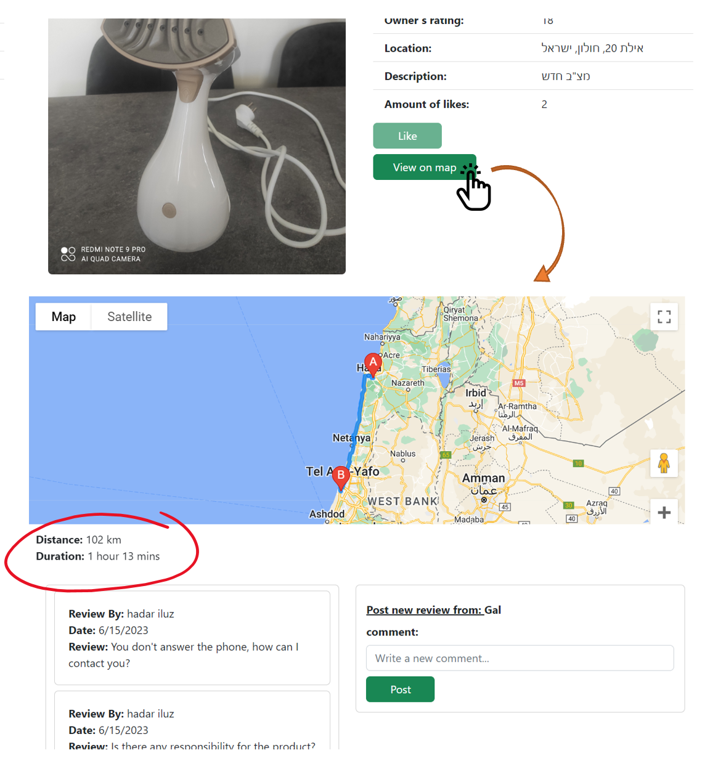
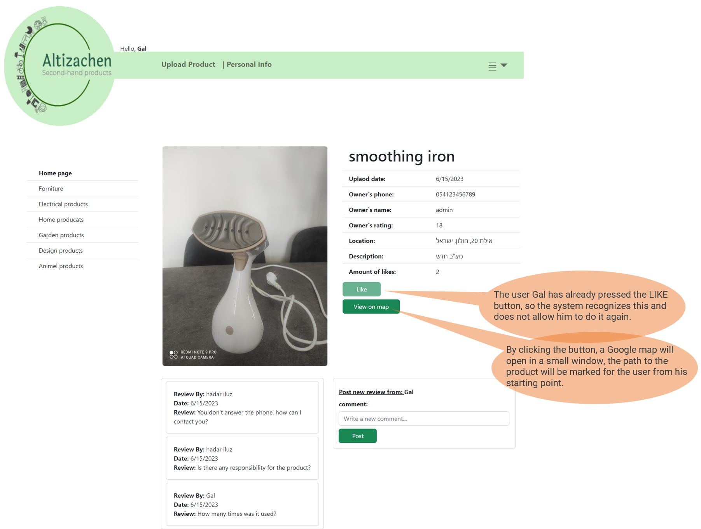
The Website- View ad by google maps
15

Slide 17
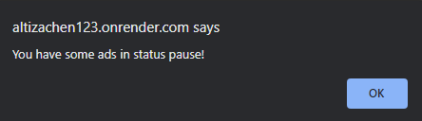
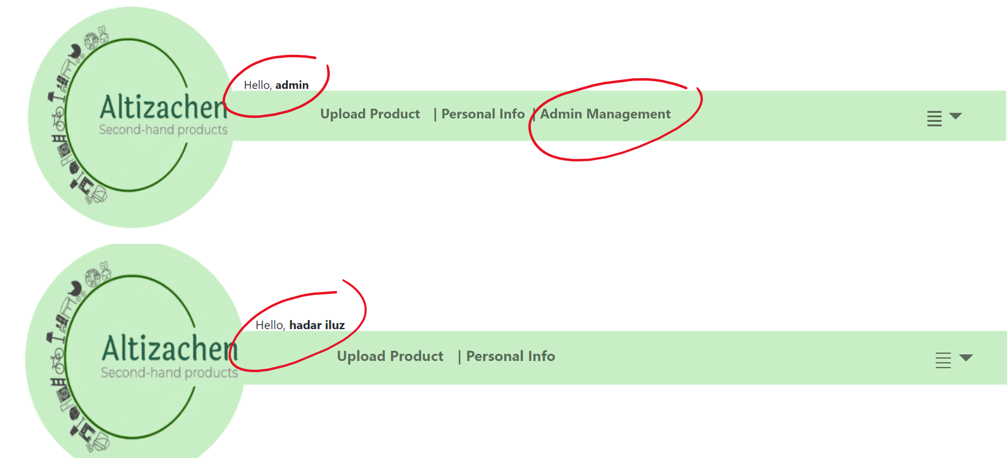
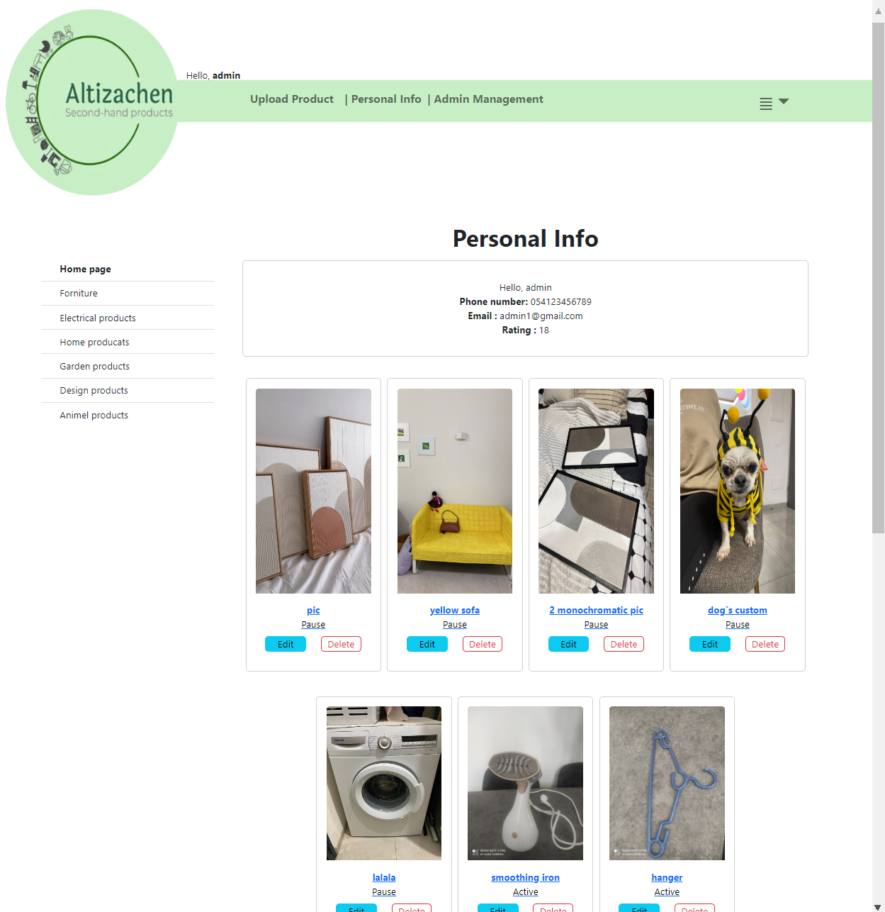
The Website- personal info
16

Slide 18
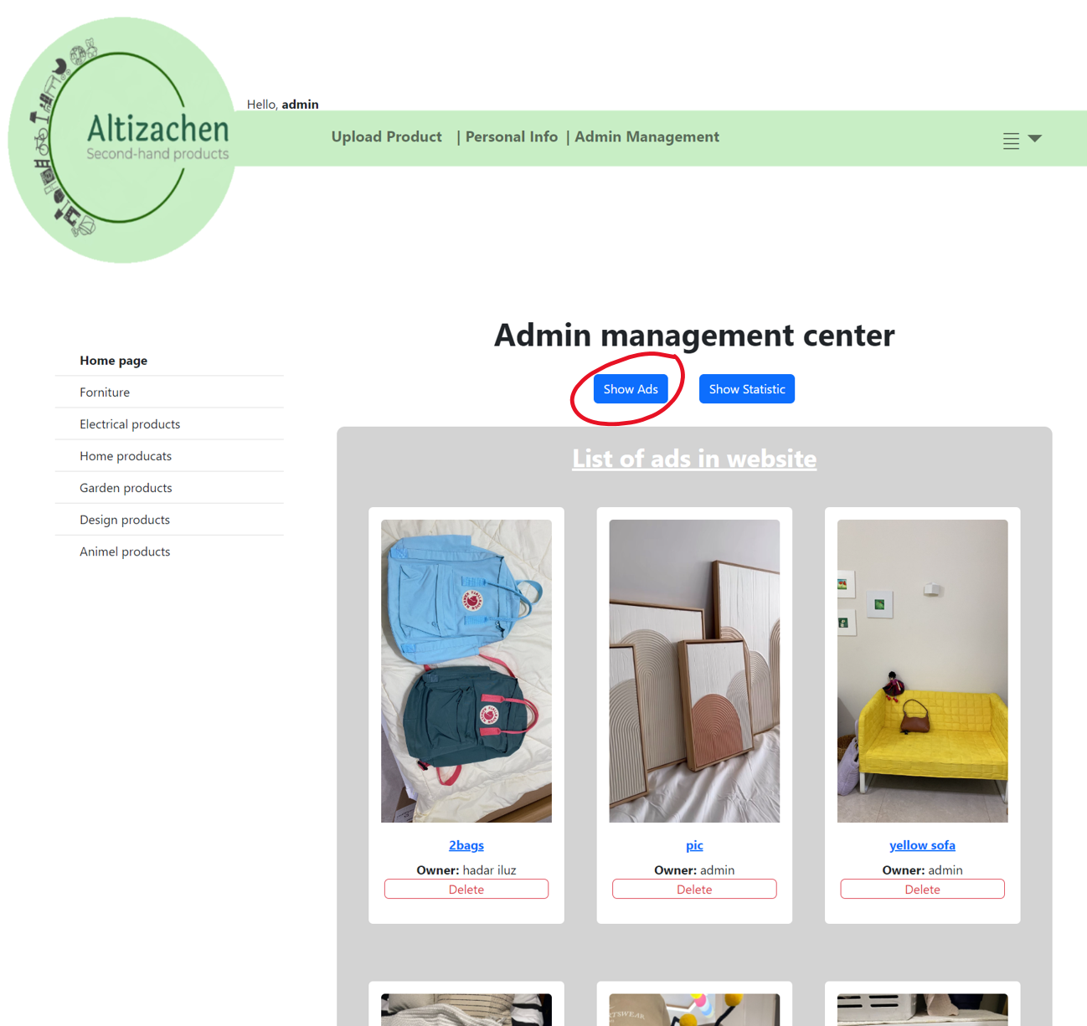
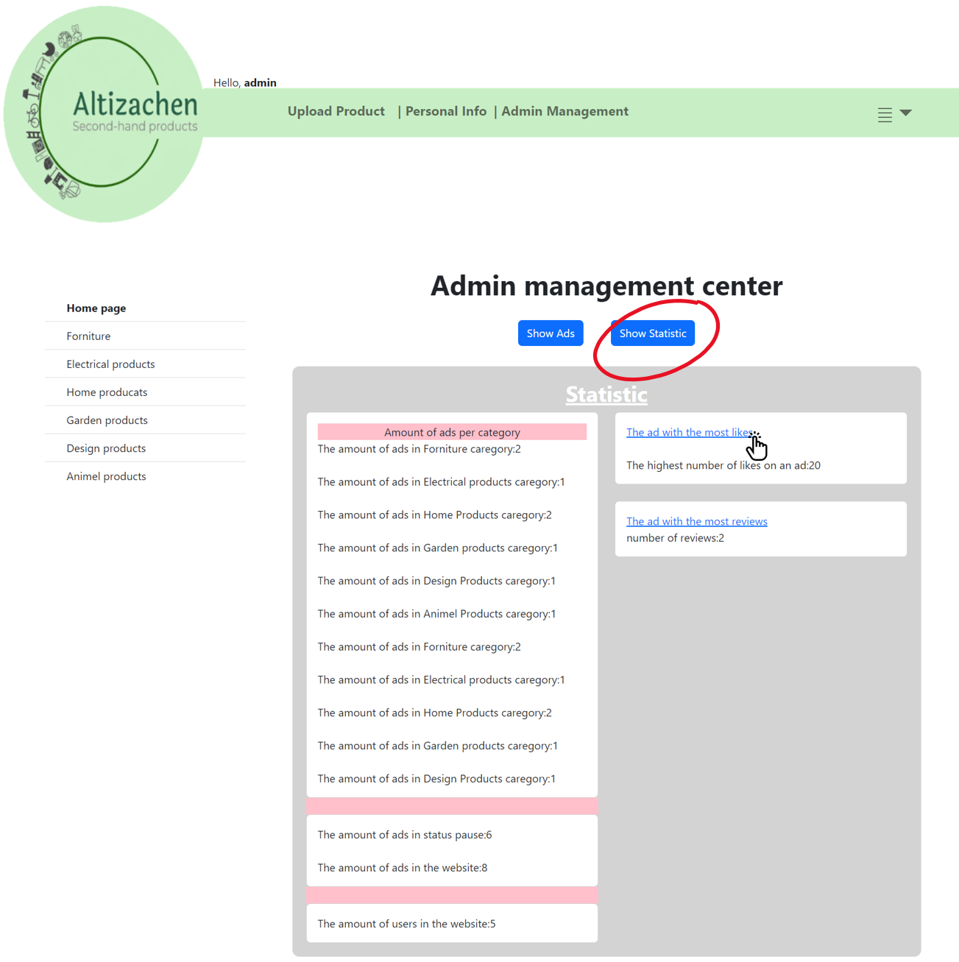
The Website- Admin management center
17

Slide 19
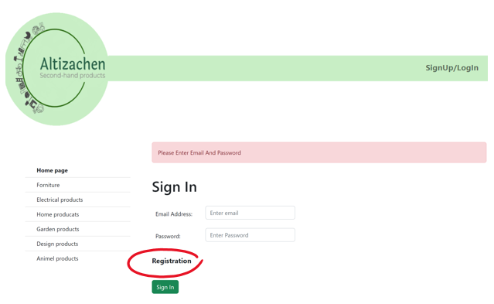
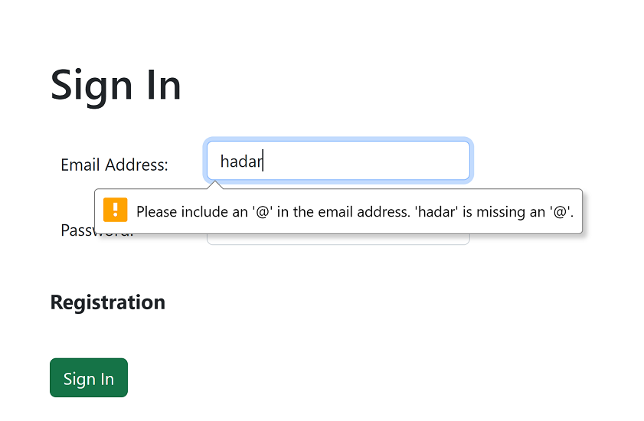
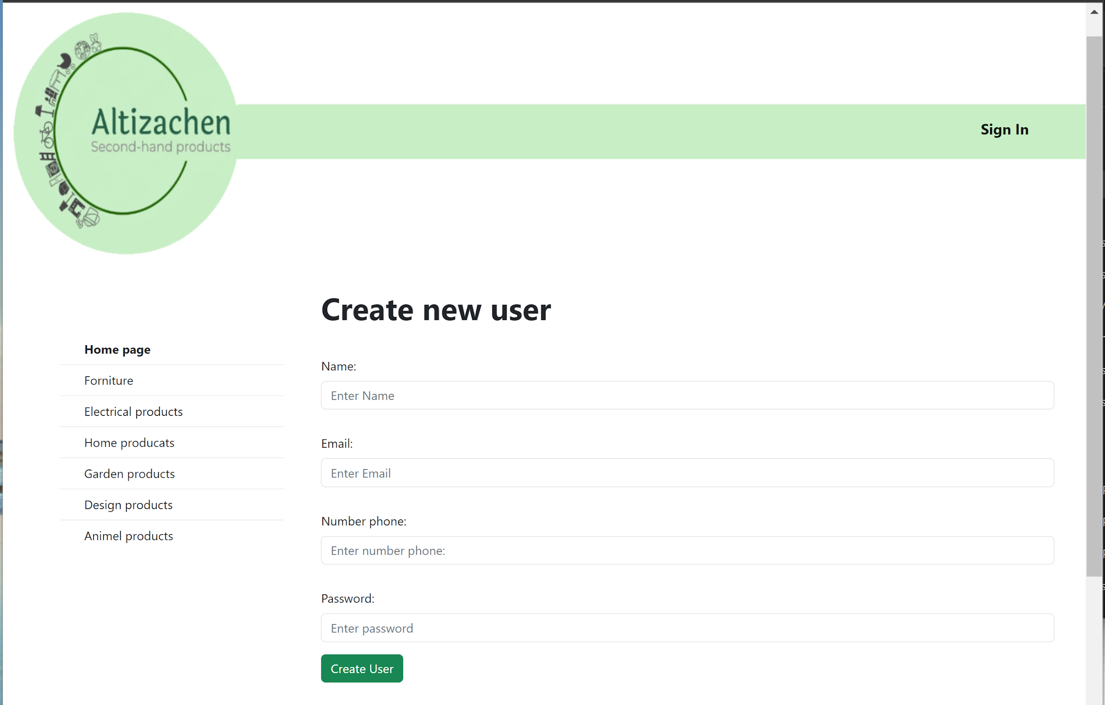
The Website- Login and registration
18

Slide 20
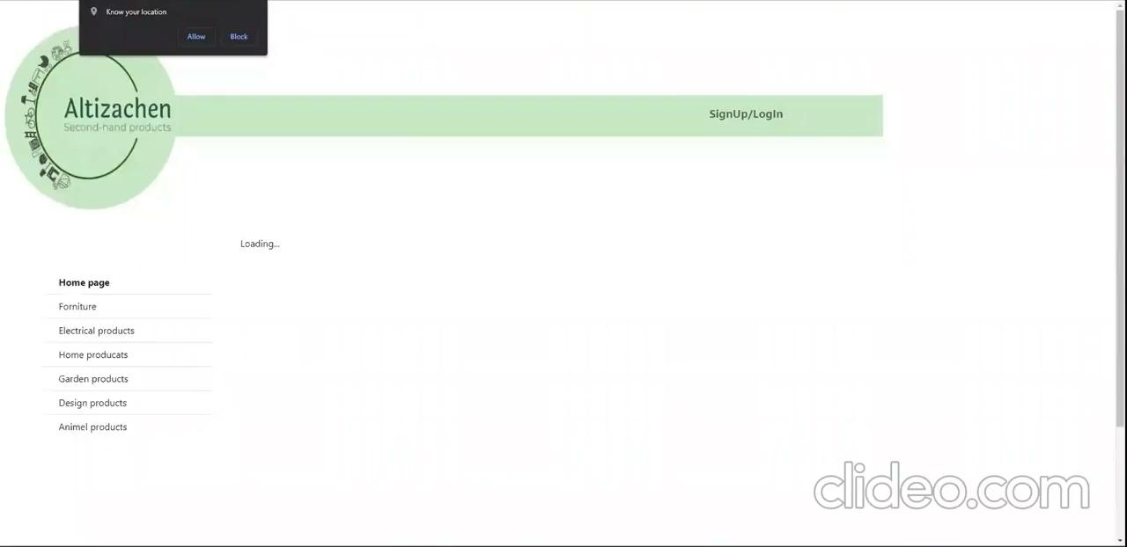
Video
- Classified ads
- Editing an ad and changing status
- Ads for VIP users
- admin center
19

Slide 21
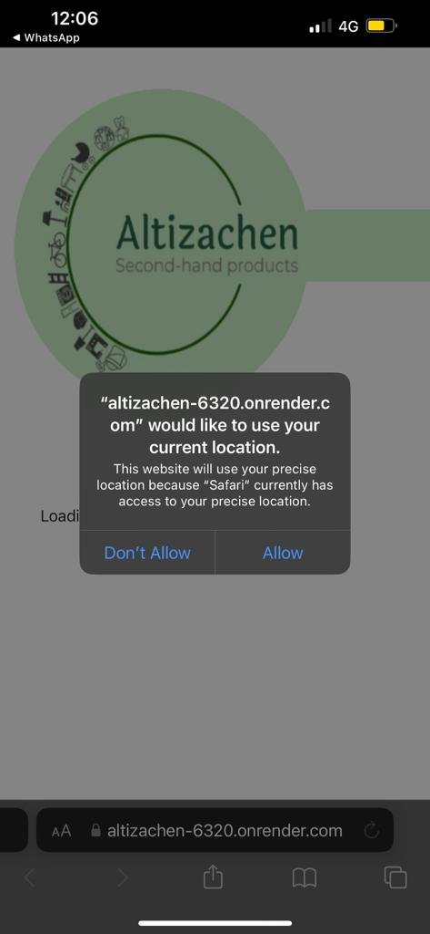
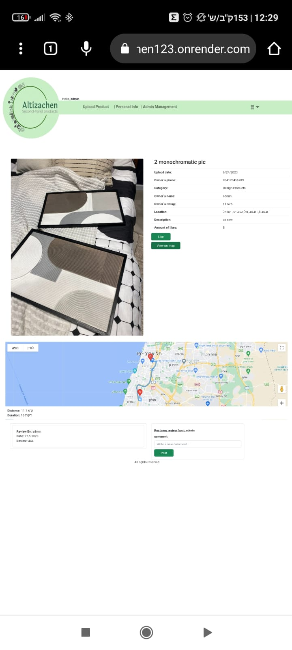
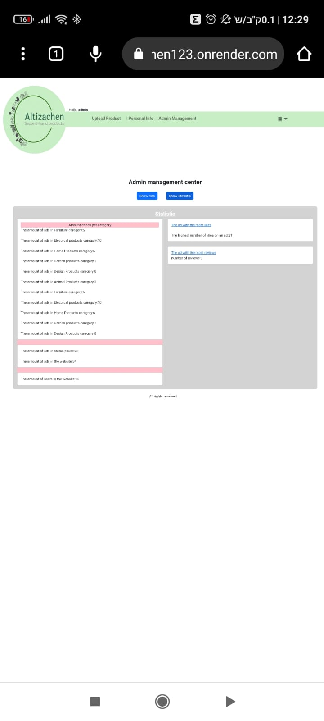
Mobile view
20

Slide 22
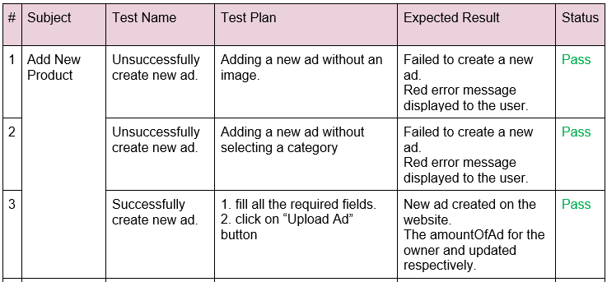
Verification- Unit Tests
21

Slide 23
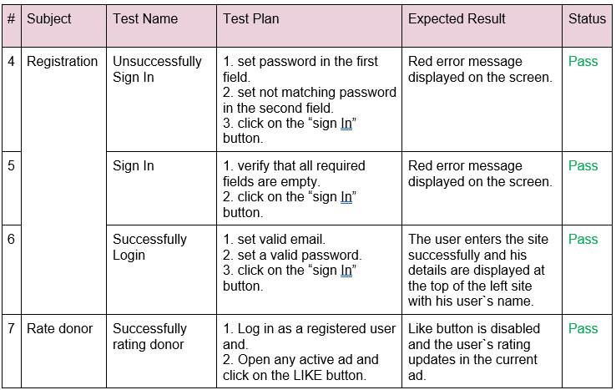
Unit Tests
22

Slide 24
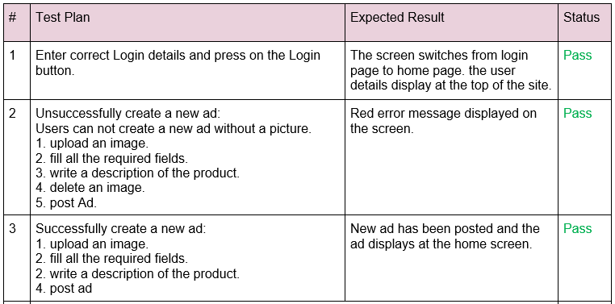
Verification- Functionality testing
23

Slide 25
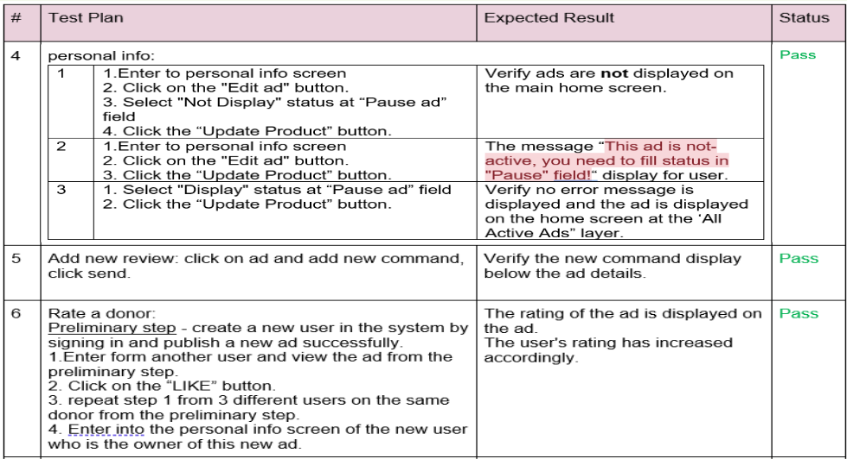
Functionality testing
24

Slide 26
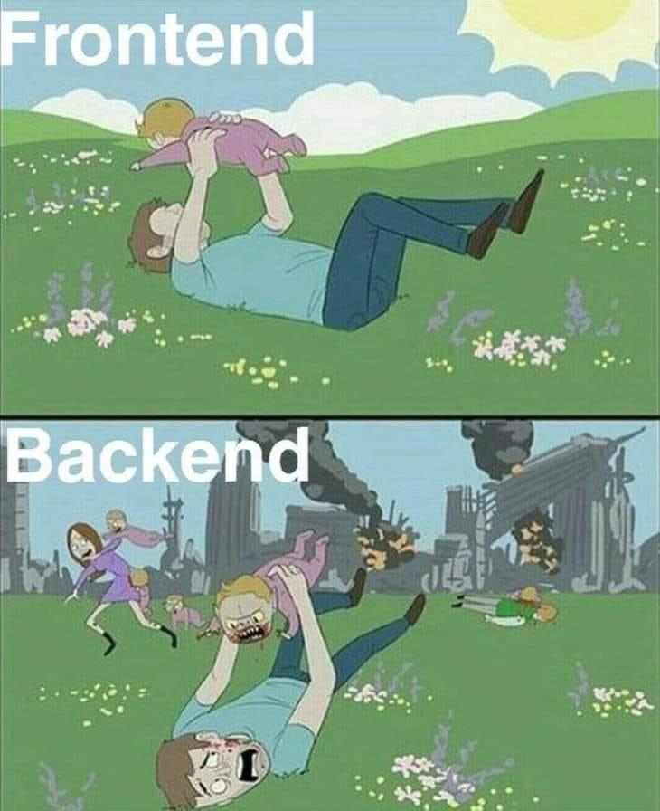
Challenges
Develop a user-friendly, cross-platform application that can operate on a wide range of platforms
Create an interface that will provide good user experience and create an easy to use interface.
Working on the project during full time job.
Work with google maps API
25

Slide 27
Thank
you!

Slide 28



Any Questions?

